Slide 1





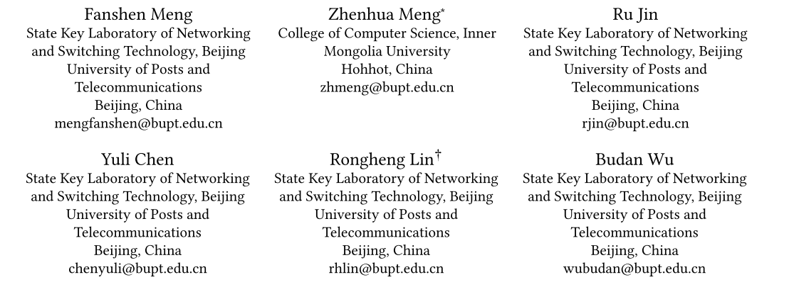



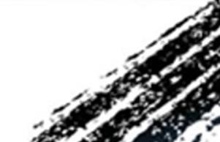

ATAI
Advanced Techniqueof Artificial Intelligence
ATAI
ChongqingUniversity _{AdvancedTechniqueof}
of Technology Artificial Intelligence
Chongqing University of
Technology
Chongqing University ^{ATAI}
_{of Technology} Advanced Techniqueof
Artificial Intelligence
Chongqing University of Technology
Chongqing University of Technology
TAMER: Interest Tree Augmented Modality Graph Recommender
for Multimodal Recommendation
Code:https://github.com/Z-last-ONE/TAMER
—— MM_2025
Reported by Junsi Chen
1

Slide 2

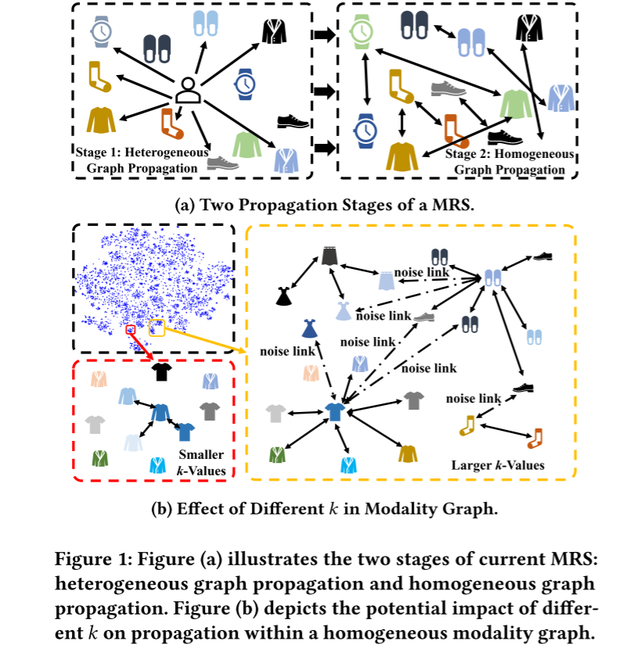
ATAI
AdvancedTechniqueof
Artificial Intelligence
ATAI
ChongqingUniversity _{AdvancedTechniqueof}
of Technology Artificial Intelligence
ChongqingUniversity of Technology
Motivation
1: Pre-trained text embeddings exhibit an average cosine similarity as high as 0.8, which not only weakens the model’s ability to differentiate features within the embedding space but also increases the risk of gradient explosion, compromising the stability and effectiveness of the recommendation model.
2: The representational capability of the frozen modality graph pruned via top-k completely depends on the original distribution of modality features and the choice of 𝑘.

Slide 3

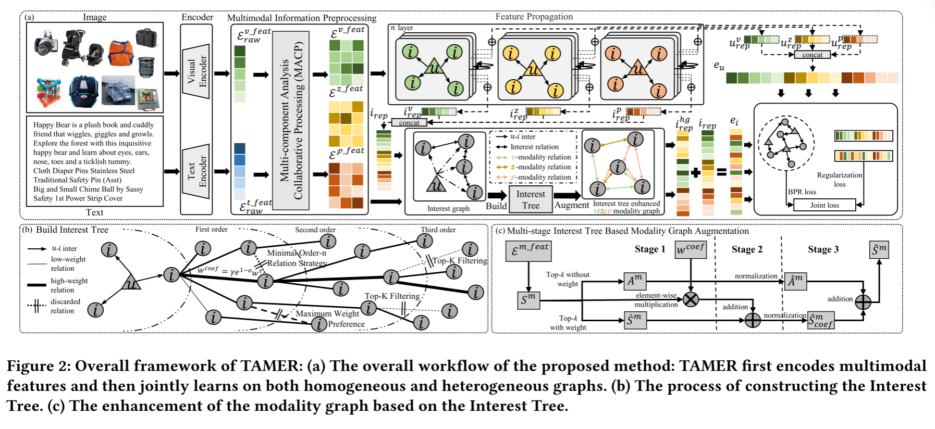
ChongqingUniversity of Technology
ATAI
AdvancedTechniqueof
Artificial Intelligence
ATAI
ChongqingUniversity _{AdvancedTechniqueof}
of Technology Artificial Intelligence
Overview

Slide 4
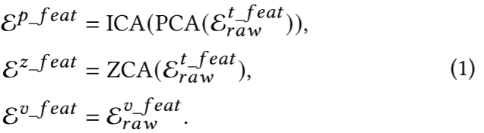
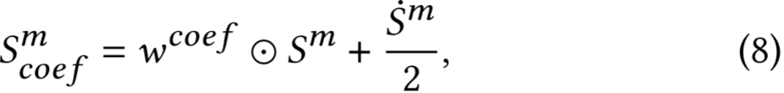
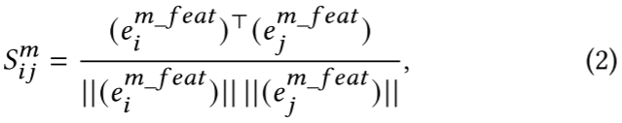
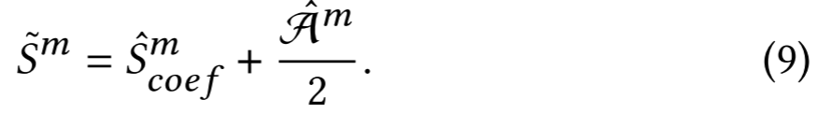
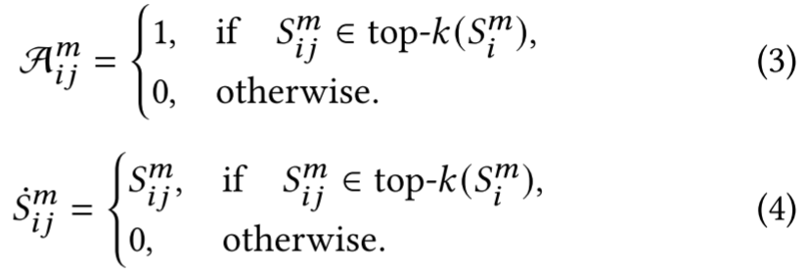
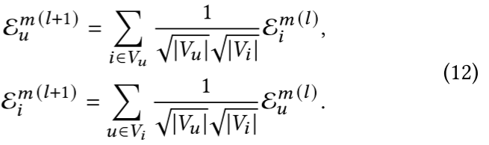

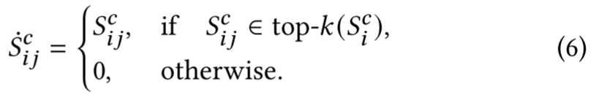
ChongqingUniversity of Technology
ATAI
AdvancedTechniqueof
Artificial Intelligence
ATAI
ChongqingUniversity _{AdvancedTechniqueof}
of Technology Artificial Intelligence
Method

Slide 5
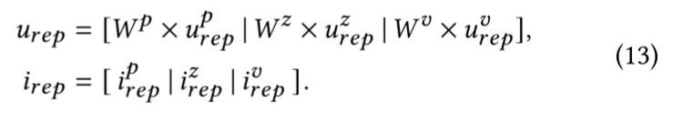
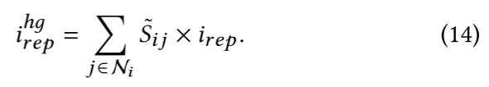


ChongqingUniversity of Technology
ATAI
AdvancedTechniqueof
Artificial Intelligence
ATAI
ChongqingUniversity _{AdvancedTechniqueof}
of Technology Artificial Intelligence
Method

Slide 6

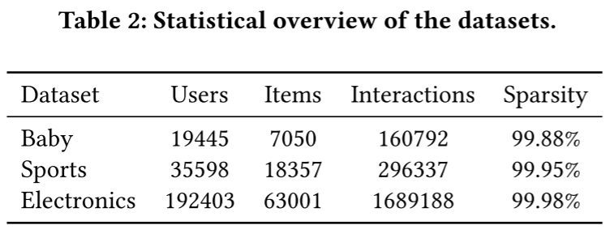
ATAI
AdvancedTechniqueof
Artificial Intelligence
ATAI
ChongqingUniversity _{AdvancedTechniqueof}
of Technology Artificial Intelligence
ChongqingUniversity of Technology
Experiments

Slide 7
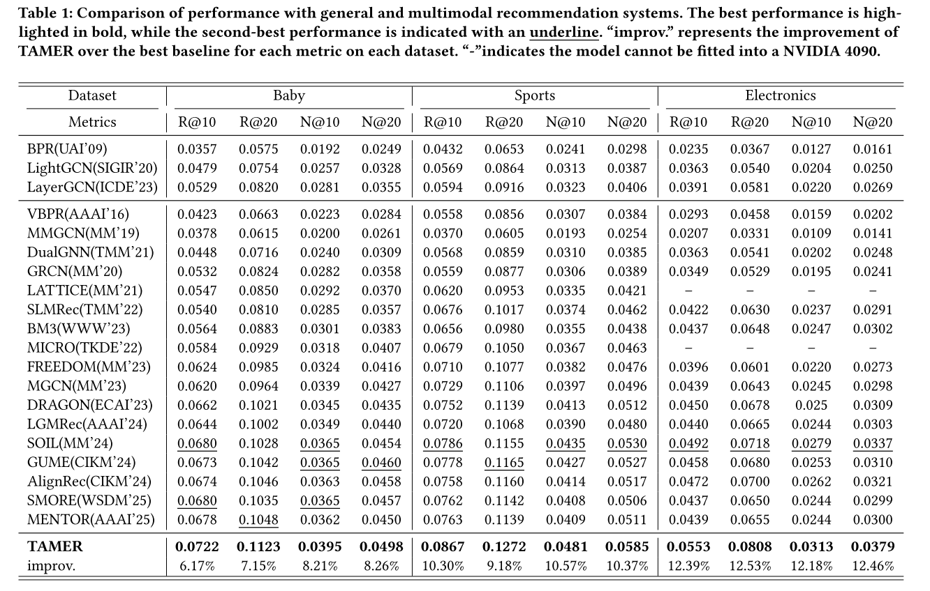
ATAI
AdvancedTechniqueof
Artificial Intelligence
ATAI
ChongqingUniversity _{AdvancedTechniqueof}
of Technology Artificial Intelligence
ChongqingUniversity of Technology
Experiments

Slide 8
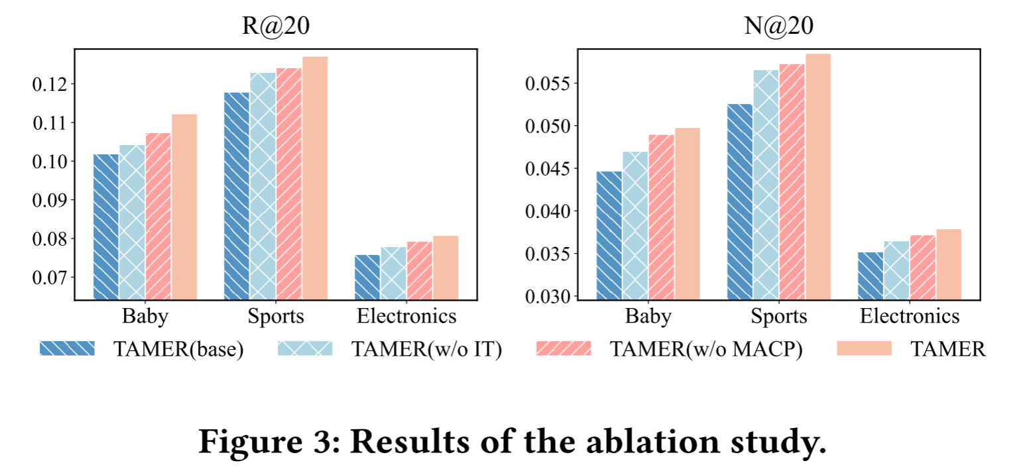
ATAI
AdvancedTechniqueof
Artificial Intelligence
ATAI
ChongqingUniversity _{AdvancedTechniqueof}
of Technology Artificial Intelligence
ChongqingUniversity of Technology
Experiments

Slide 9
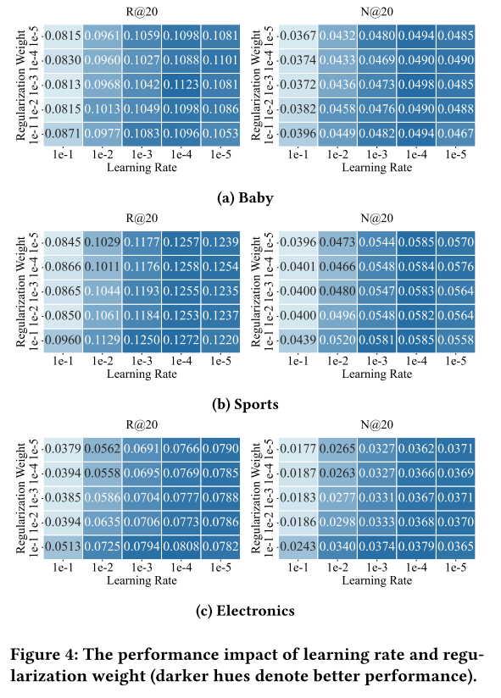
ATAI
AdvancedTechniqueof
Artificial Intelligence
ATAI
ChongqingUniversity _{AdvancedTechniqueof}
of Technology Artificial Intelligence
ChongqingUniversity of Technology
Experiments

Slide 10
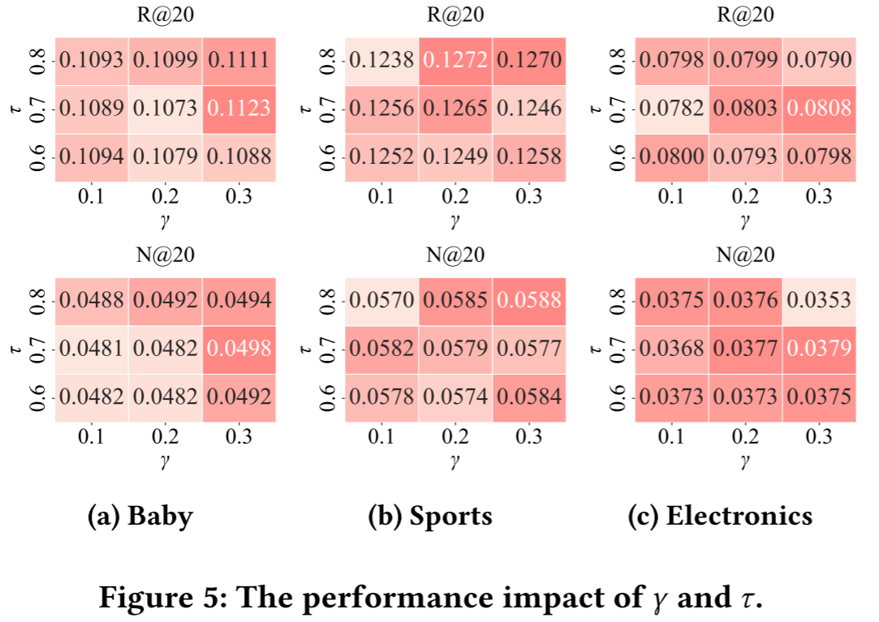
ATAI
AdvancedTechniqueof
Artificial Intelligence
ATAI
ChongqingUniversity _{AdvancedTechniqueof}
of Technology Artificial Intelligence
ChongqingUniversity of Technology
Experiments

Slide 11
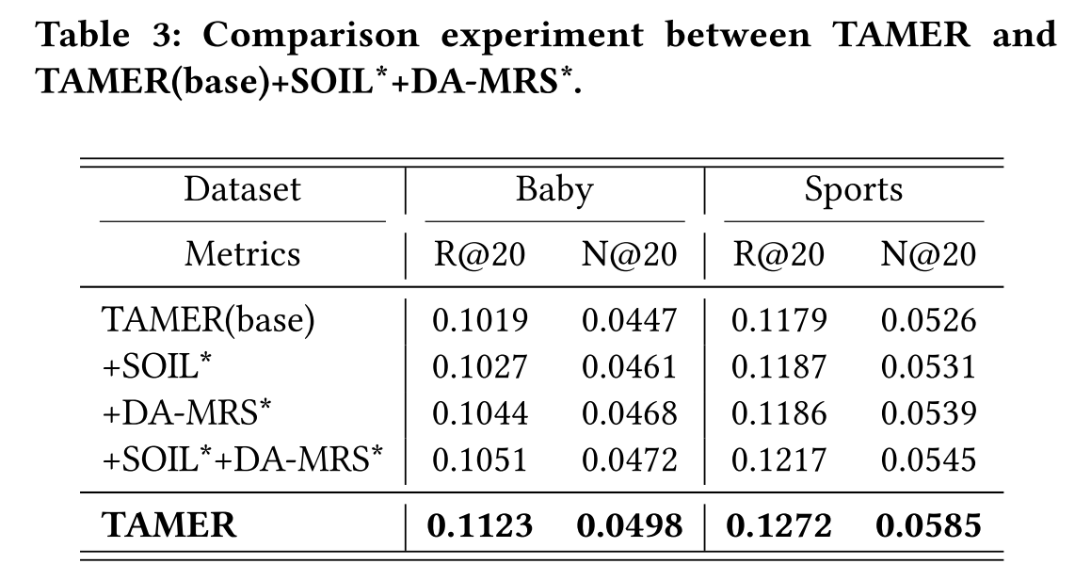
ATAI
AdvancedTechniqueof
Artificial Intelligence
ATAI
ChongqingUniversity _{AdvancedTechniqueof}
of Technology Artificial Intelligence
ChongqingUniversity of Technology
Experiments

Slide 12
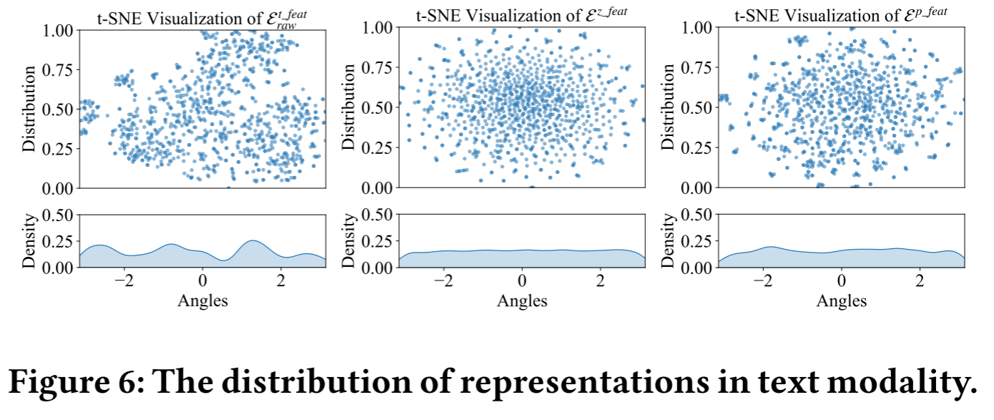
ATAI
AdvancedTechniqueof
Artificial Intelligence
ATAI
ChongqingUniversity _{AdvancedTechniqueof}
of Technology Artificial Intelligence
ChongqingUniversity of Technology
Experiments

Slide 13
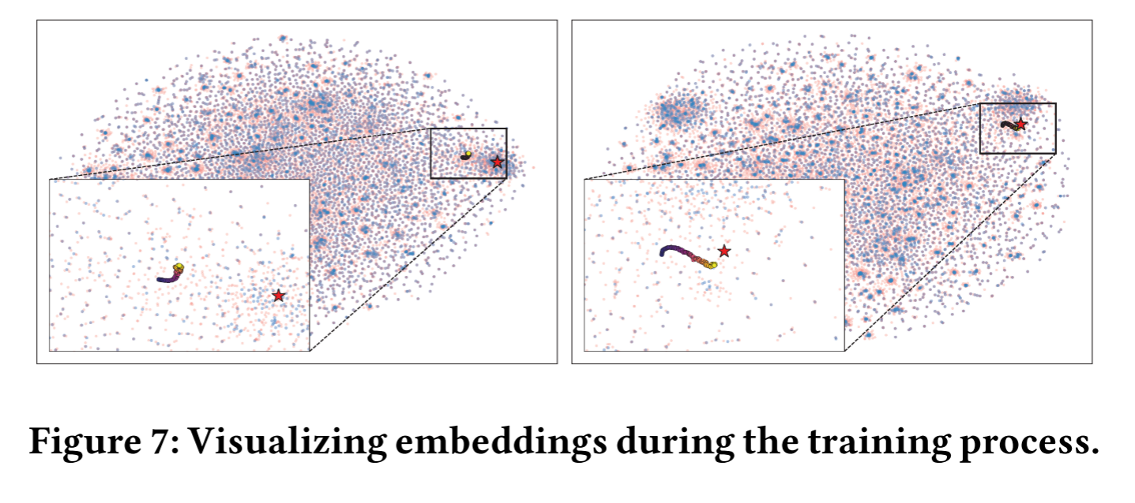
ATAI
AdvancedTechniqueof
Artificial Intelligence
ATAI
ChongqingUniversity _{AdvancedTechniqueof}
of Technology Artificial Intelligence
ChongqingUniversity of Technology
Experiments

Slide 14


ChongqingUniversity of Technology
ATAI
AdvancedTechniqueof
Artificial Intelligence
ATAI
ChongqingUniversity _{AdvancedTechniqueof}
of Technology Artificial Intelligence
Thanks!

